Slide 1
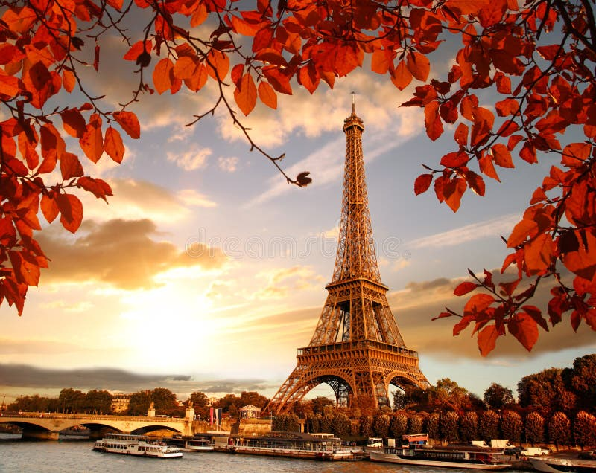
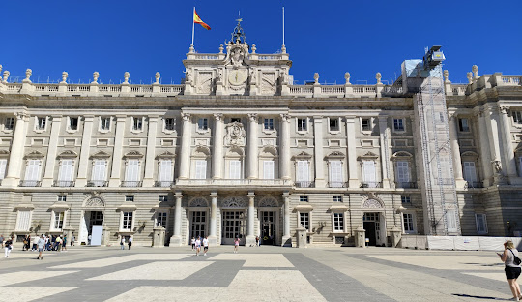
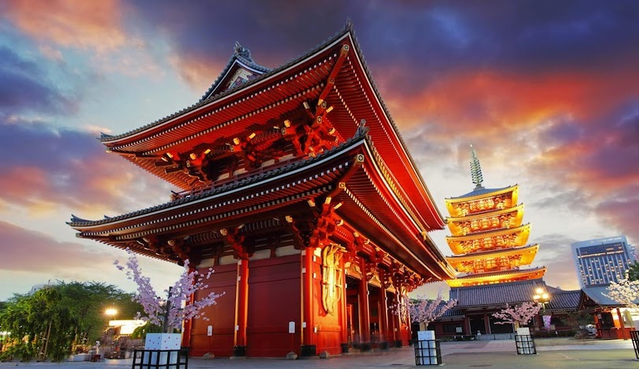
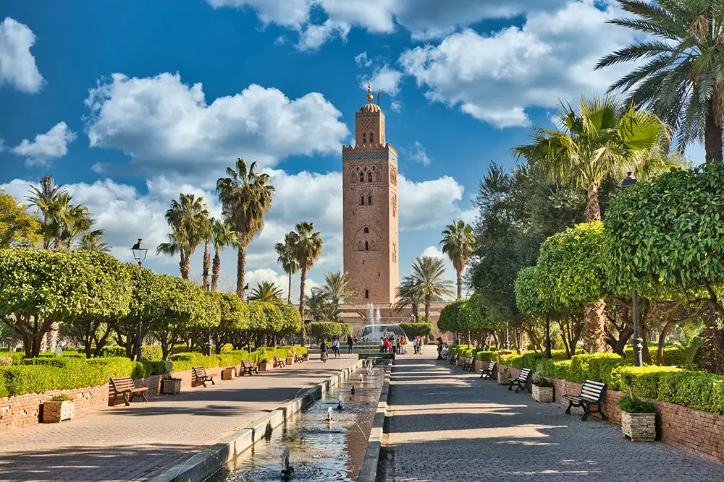
THE BEST CITY IN THE WORLD

Slide 2
THE BEST CITY IN THE WORLD
Paris
Often #1 for tourism, praised for culture, infrastructure, sustainability, and recent developments like the Notre-Dame reopening.

Slide 3
THE BEST CITY IN THE WORLD
Madrid
Consistently ranks high (often #2) for tourism and visitor appeal, says CNN and Forbes.

Slide 4
THE BEST CITY IN THE WORLD
Marrakesh
Marrakesh, a former imperial city in western Morocco, is a major economic center and home to mosques, palaces and gardens. The medina is a densely packed, walled medieval city dating to the Berber Empire,

Slide 5
THE BEST CITY IN THE WORLD
Tokyo
A major draw for its unique megacity experience, culture, and record tourism, notes CNN and World's Best Cities.

