Slide 1
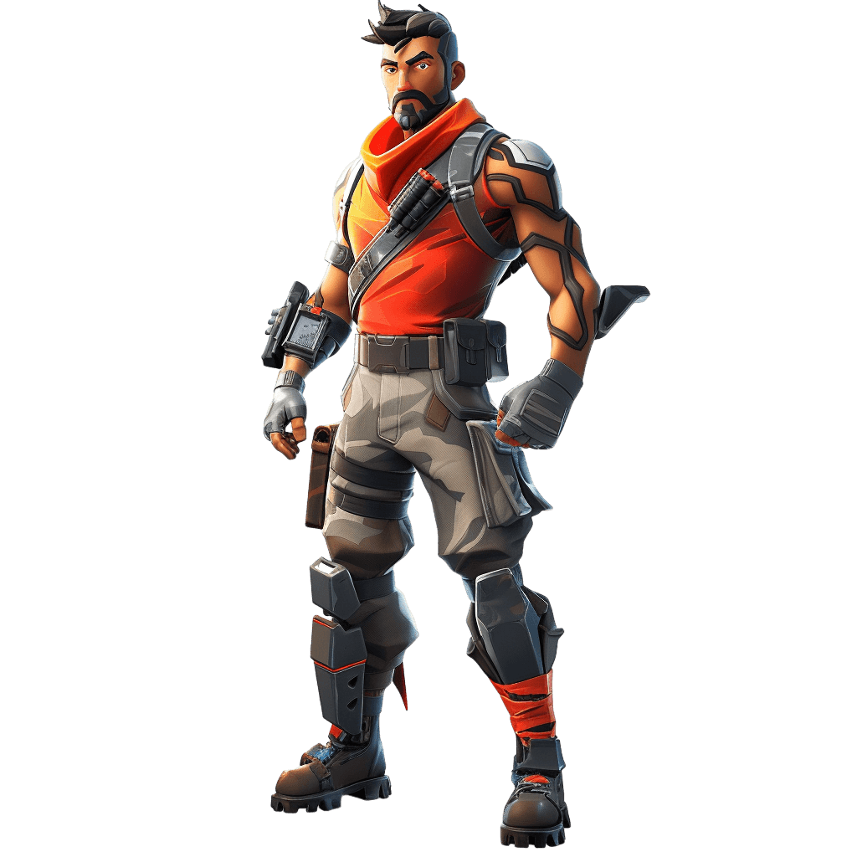
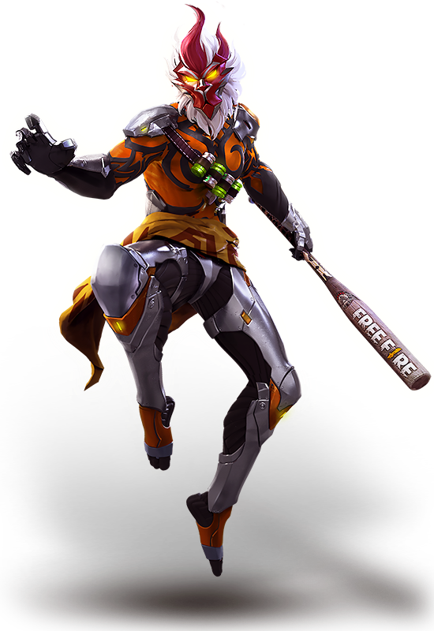
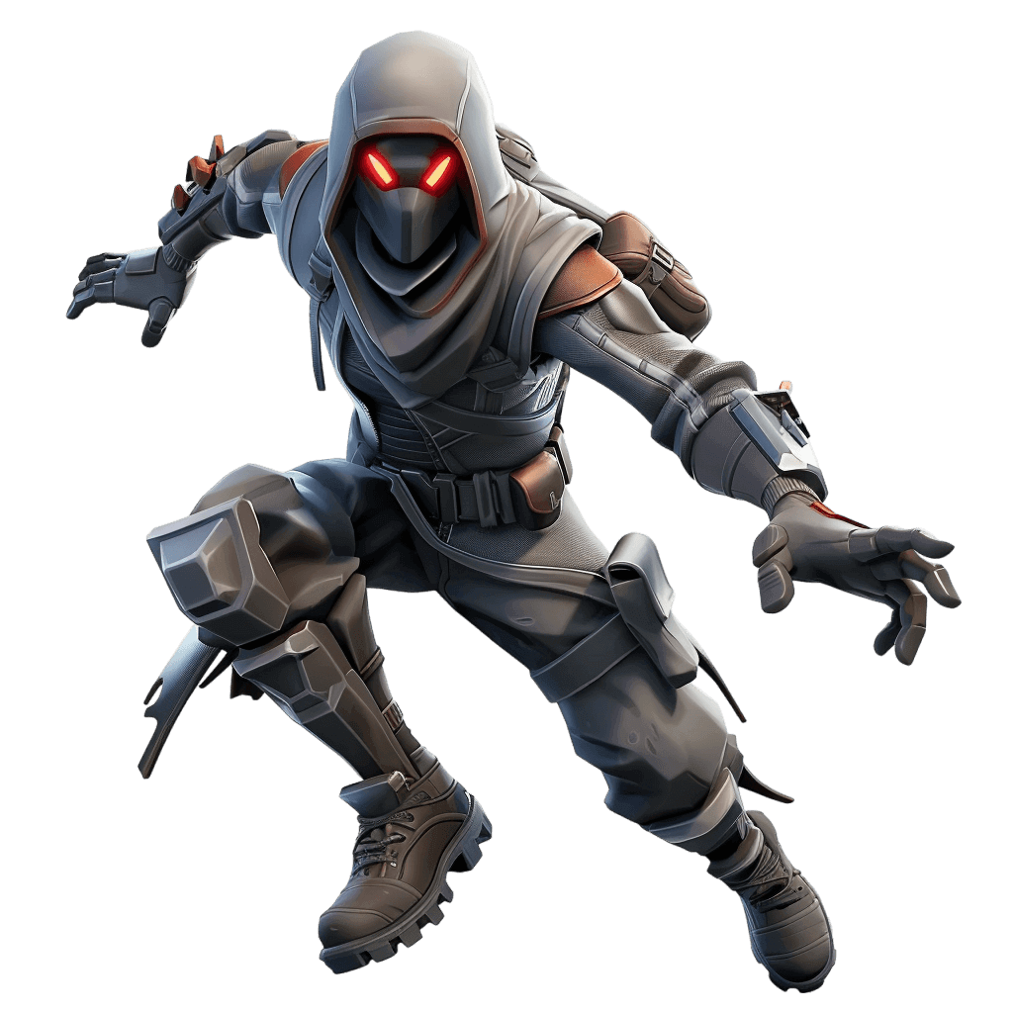

Slide 2
Wukong
Wukong is a character in Garena Free Fire. His ability is Camouflage. Descriptions A Monkey that looks like a humanbeing. He still likes bananas, though.

Slide 3
Raptor
Raptor is a legendary outfit in Fortnite: Battle Royale, known for its distinctive yellow and black pilot-style gear, including a yellow hooded jacket, a black

Slide 4
Shadow Ops
Shadow Ops is an Epic Outfit in Fortnite, that can be purchased in the Item Shop for 1,500 V-Bucks or with Power Shong's Locker Bundle for 2,500 V-Bucks.

